Slide 1
LNHS PTSA Wednesday
September 20, 2023 6:30pm

Slide 2
Our mission is to make every child’s potential a reality by engaging and empowering families and communities
to advocate for all children.
To help our students succeed
by building strong community partnerships,
supporting teachers and staff,
providing quality STEM opportunities,
and making college and career connections.

Slide 3
PTSA
Financial Update August 2023
Starting Balance $17,192.43
Ending Balance $13,986.79

Slide 4
PTSA MEMBERSHIP Currently 550 Memberships Received (Well OVER Halfway to Our Goal of 850!) Membership Options Parent/Adult - $10 Teachers & Staff - $5 Students - $5 Community Members - $10 (Includes Discount Card)

Slide 5
SPIRIT WEAR - Currently OVER $19,000 in income ($9,000 profit) (Return of the Pride, Athletic Games, Open House)

Slide 6
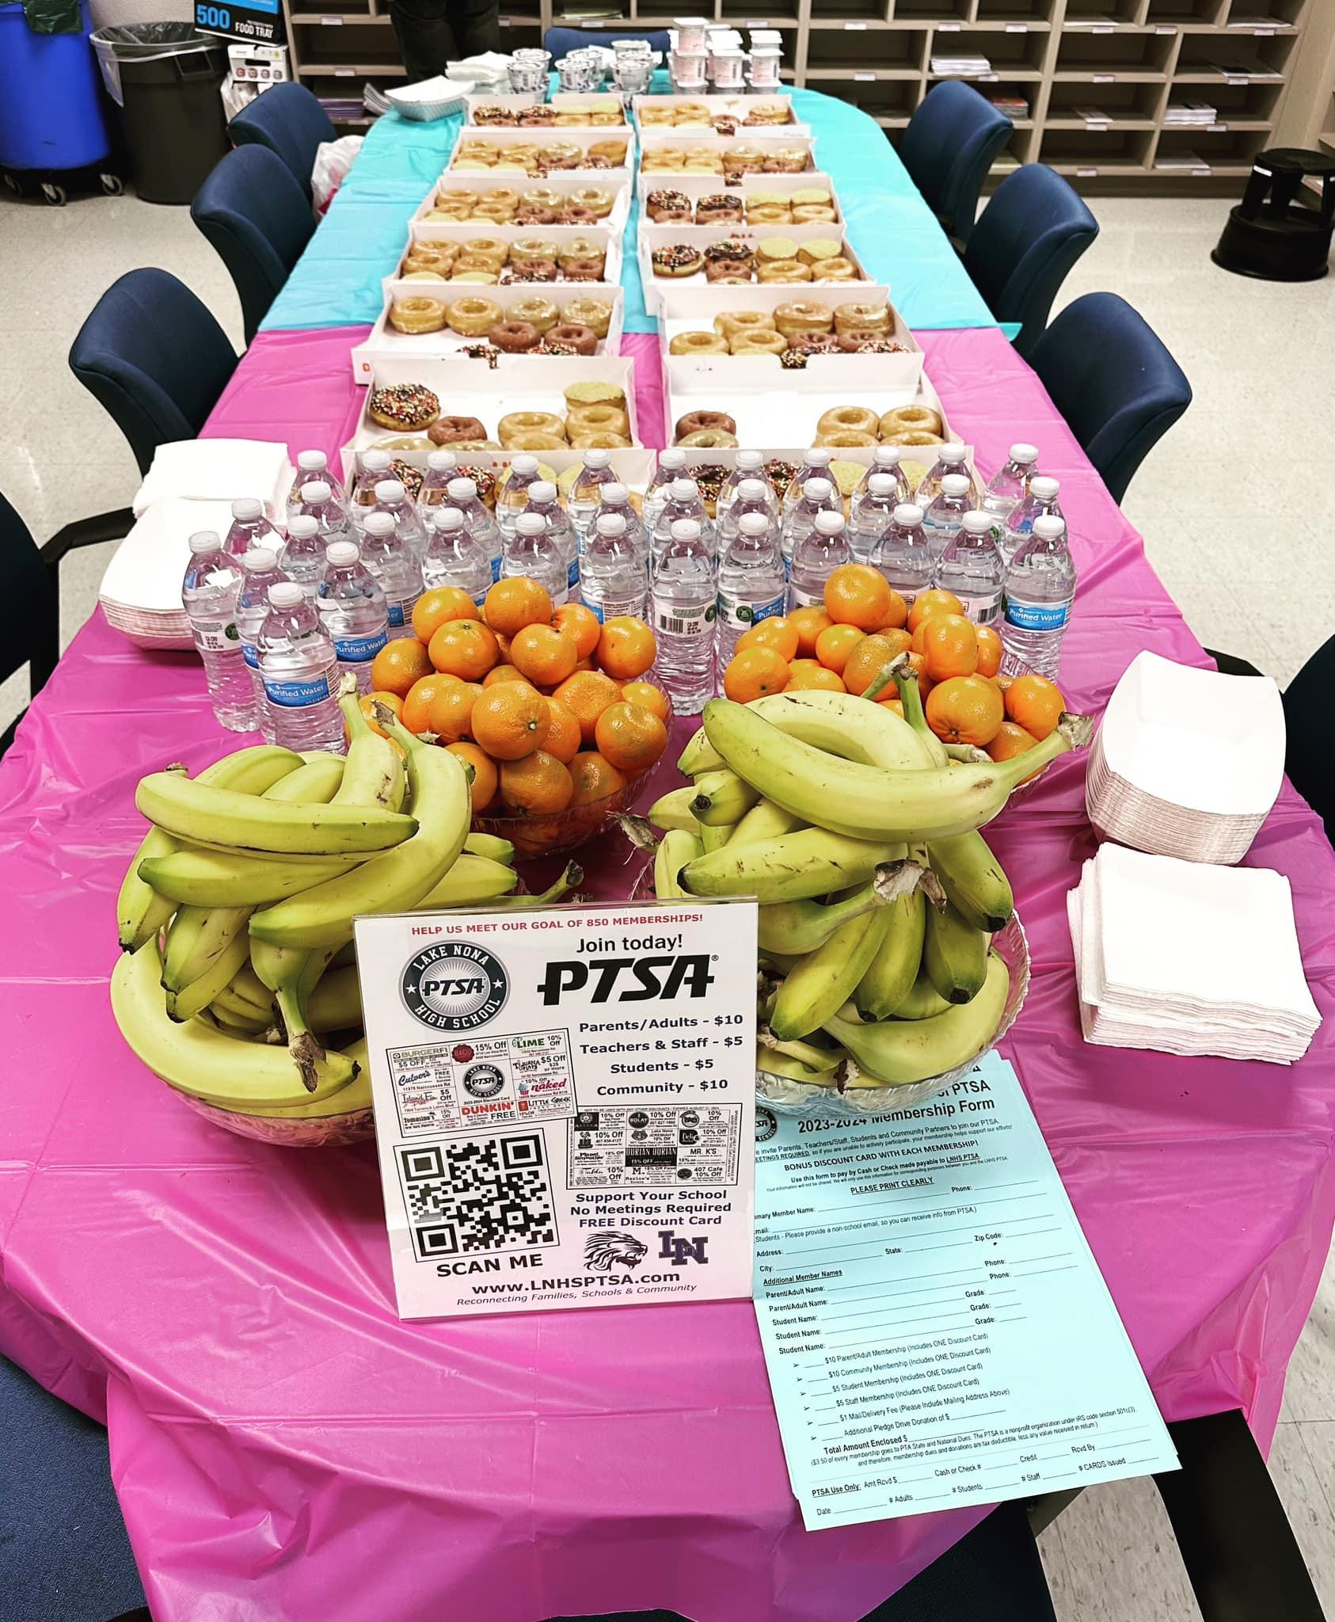
STAFF
APPRECIATION
September Event:
DONUT Underestimate our Teachers & Staff
THANK YOU TO OUR VOLUNTEERS AND COMMUNITY PARTNERS!

Slide 7
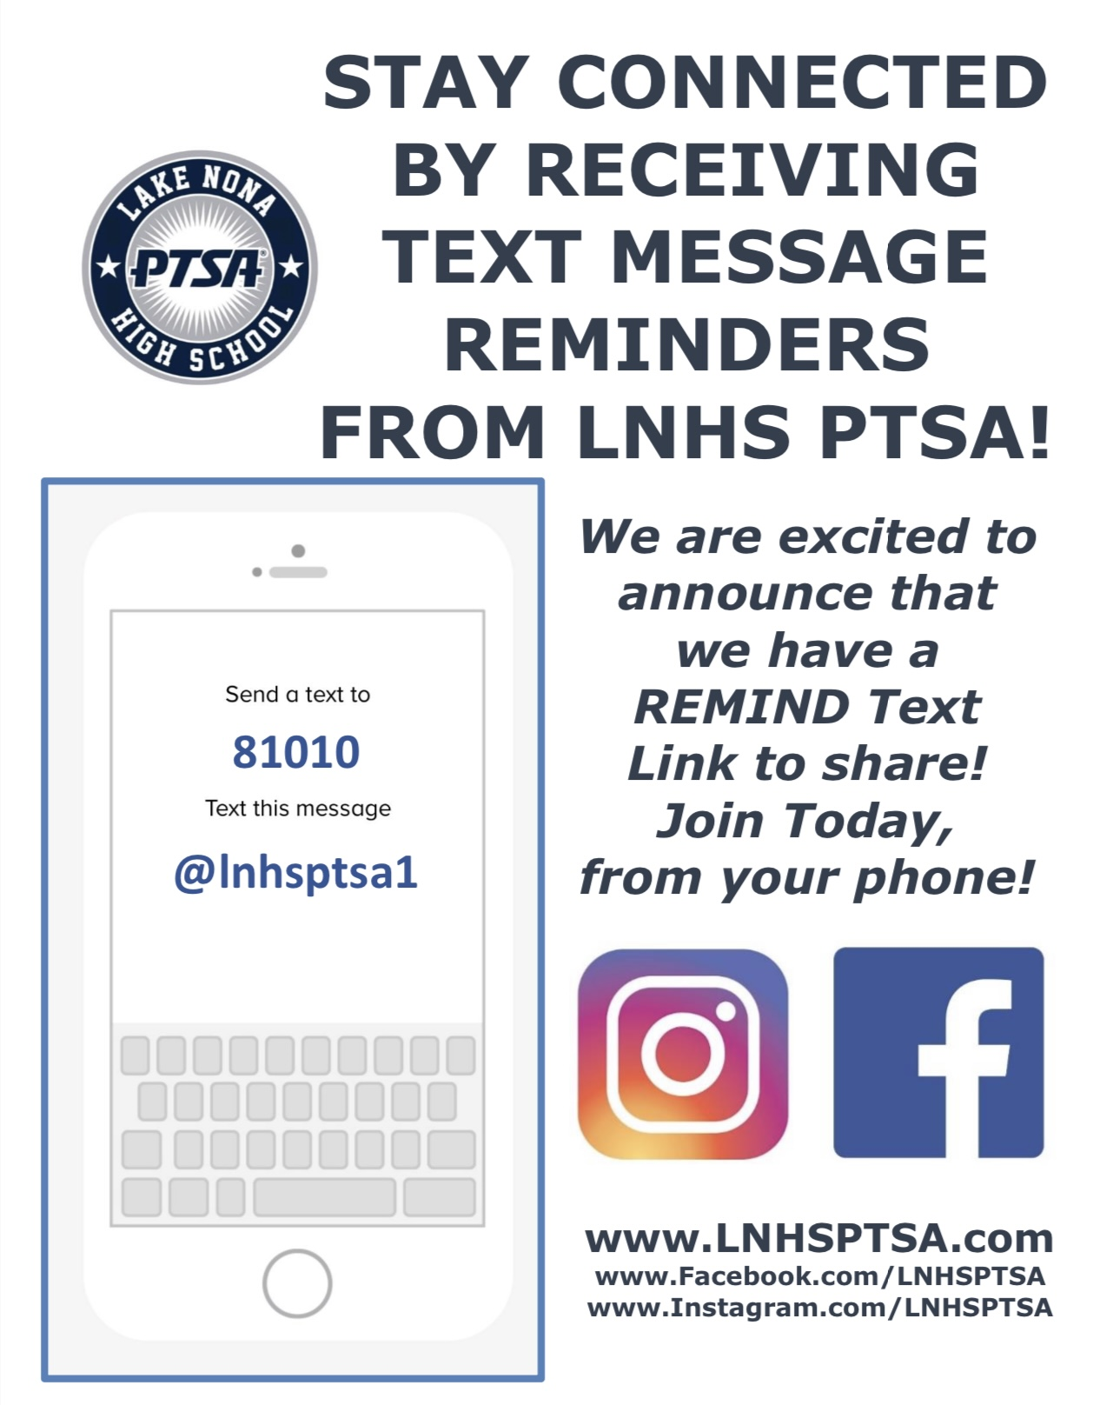
PTSA STAFF APPRECIATION

Slide 8
STAY CONNECTED
WITH LNHS PTSA
PTSA STAFF APPRECIATION
www.LNHSPTSA.com
www.Facebook.com/LNHSPTSA
SAVE THE DATE
Next General Meeting
Wednesday, October 18, 2023 at 6:30pm

Slide 10
Administrators:
Travis Bryant (Travis.bryant@ocps.net) – Assistant Principal
ESE/504 Department
CTE Department
Transportation Liaison
Clinic
Tonny Harris (Tonny.harris@ocps.net) - Assistant Principal
Science Department
Facilities
Athletics
Safety and Emergency Management
AP/AICE Studies
Wilicia Hughes (Wilicia.hughes@ocps.net) – Assistant Principal
Math Department
Reading Department
Media Center
Tutoring
Devices
Stephen Morsher (Stephen.morsher@ocps.net) – Assistant Principal
English Department
Visual and Performing Arts Departments
State Testing
Parking
Campus Activities/Clubs/Organizations
Juliza Rivera (Juliza.rivera@ocps.net) –Assistant Principal
World Languages Department
Student Services
ELL Support and Services
Linda Van (Linda.van@ocps.net) – Assistant Principal
Social Studies Department
Discipline
Attendance
Clerical
Maricarmen Aponte (Maricarmen.aponte@ocps.net) -Acting Principal

Slide 11
Who to contact for specific questions:
Skyward Help: Chelsea.john@ocps.net
Student Parking Passes and Parent Hang-Tags: Stephen.morsher@ocps.net
PE Uniforms: Travis.bryant@ocps.net
Laptops: Cristen.krugh@ocps.net
School Lunch: linda.van@ocps.net
Athletics: Brandon.joseph@ocps.net
Student Services: Juliza.rivera@ocps.net
Staffing Specialist: Phoebe.storey@ocps.net
504 Coordinator: Olga.cecilio@ocps.net
ESOL Compliance: Lyralis.vargas@ocps.net
Talking Points Support: Cristina.dry@ocps.net
School Nurse: Kelly.coughenour@ocps.net
Testing Coordinators: Lisa.nowlen@ocps.net andJamie.quinn@ocps.net
Deans: Timothy.freund@ocps.net and Kevin.morgan@ocps.net
SAFE Coordinator: Tammy.whitfield@ocps.net
School Social Worker: Laura.kempfer@ocps.net
SchoolPay: Lisa.wilcox@ocps.net
Yearbooks: Katherine.youngross@ocps.net
SGA and Senior Class: Joel.adkins@ocps.net
College and Career: Shanel.morris@ocps.net
CTE Career Specialist: Eileen.gonzalez@ocps.net

